Slide 1
Summerfield Music School
Michael Amoo

Slide 2
Services
Instruction
Instruments
Performance

Slide 3

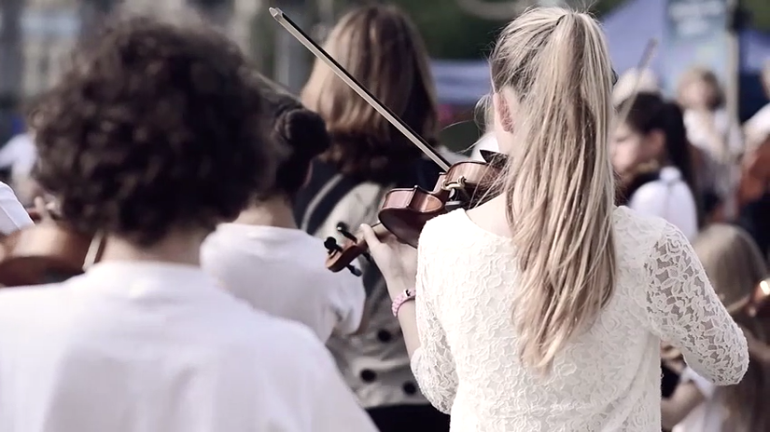
Instruction
Master Violin Class

Slide 4

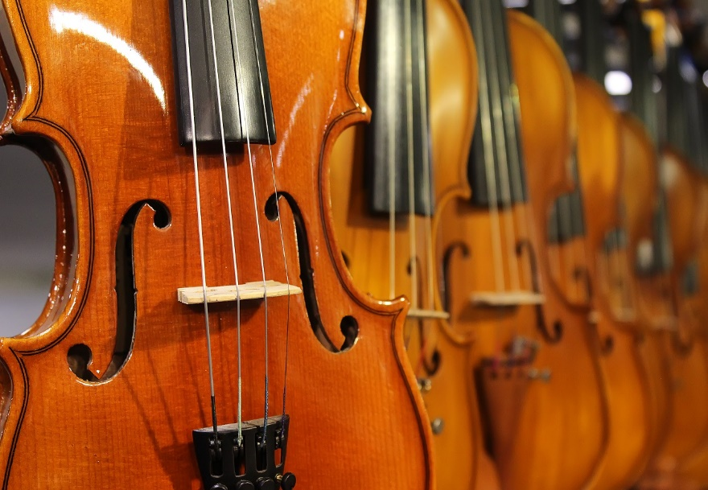

Instruments

Slide 5

Performance
A song
in our hearts…
Brings happiness to our faces

Slide 6
Enrollment
Application
Financial Aid
Advising & Orientation
Instrument Selection & Scheduling

Slide 7
Questions?
Contact us at:
Exploring2019@Outlook.com

